Slide 1
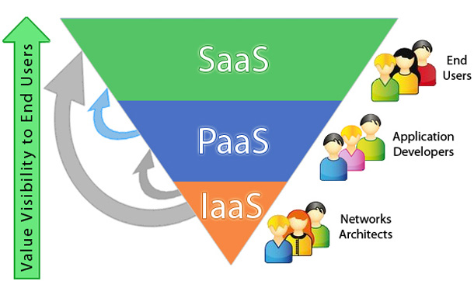
You manage the applications and services you develop and the cloud service provider typically manages everything else.
Cloud services :

Slide 2
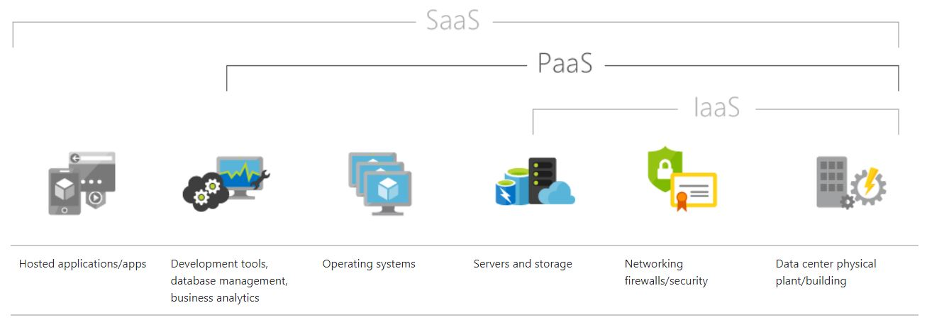
What is PaaS ?
Platform as a service (PaaS) is a complete development and deployment environment in the cloud

Slide 3
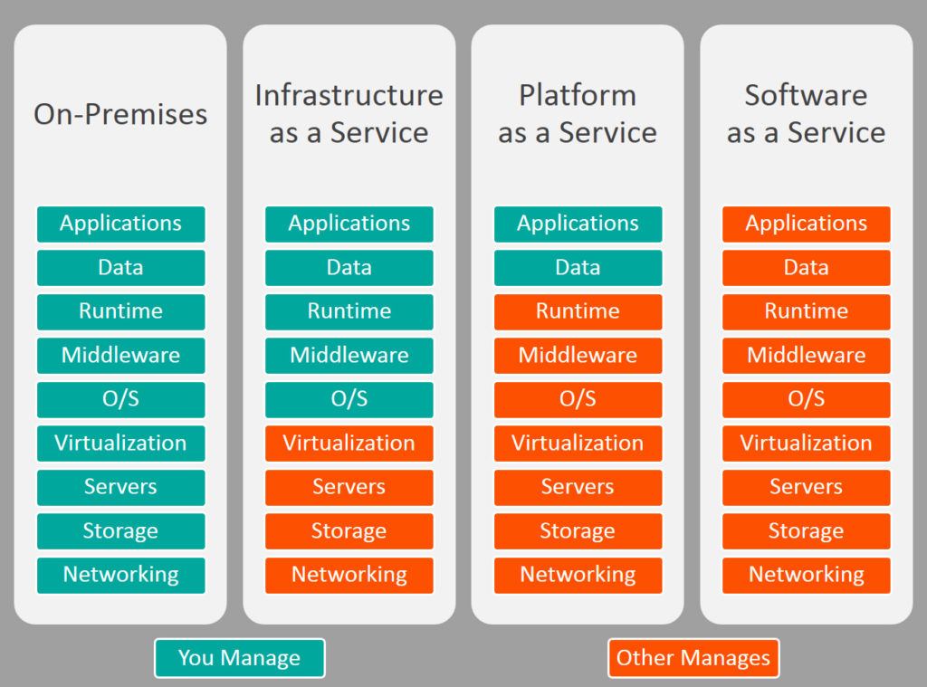
PaaS is designed to support the complete web application lifecycle: building, testing, deploying, managing and updating.

Slide 4
PaaS Deployment Models:
Public cloud deployment
Private cloud deployment
Hybrid cloud deployment
within a data center owned and controlled by the cloud service customer organization
two variants
within a data center owned and controlled by a cloud service provider but the resources used are dedicated to one cloud service customer and are isolated from resources used by other customers

Slide 5
PaaS pros and cons :
The principal benefit of PaaS is simplicity and convenience for users
the PaaS provider supplies much of the infrastructure and other IT services, which users can access anywhere via a web browser.
Service availability or resilience, DBs , storages , however, can be a concern with PaaS.

Slide 6
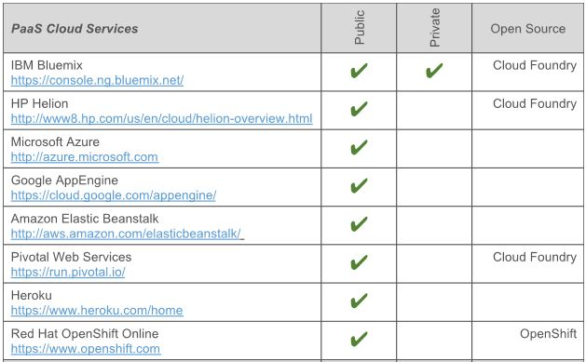
Public PaaS deployment expml :

Slide 7

Some Google AppEngine as a Public PaaS :

Slide 8
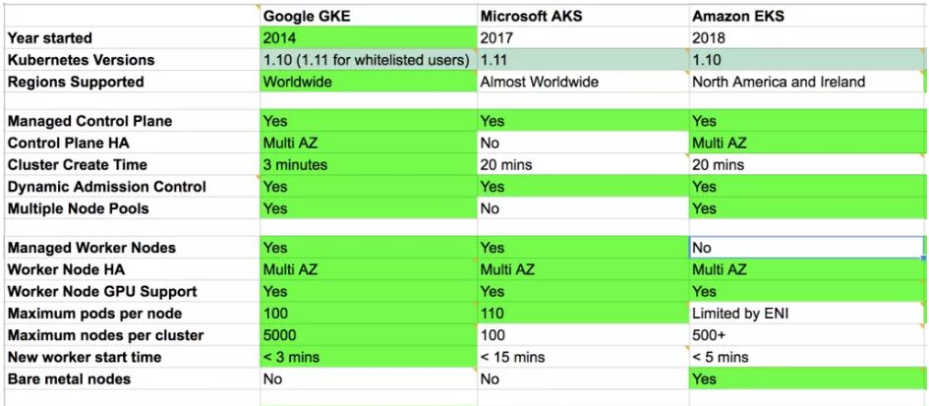
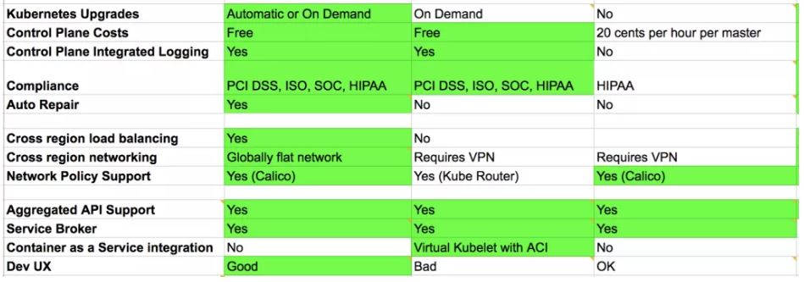

Slide 9

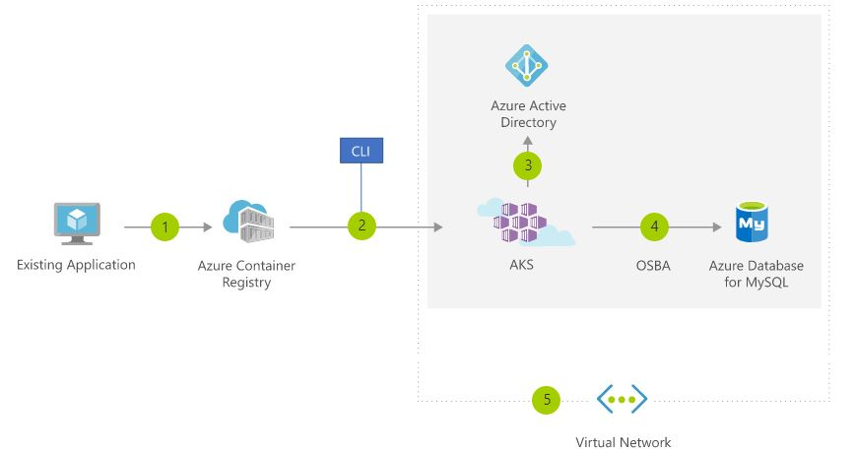
Easily migrate existing application to the cloud
AKS=Azure Kubernetes service
1-User converts existing application to container(s) and publishes container image(s)to the Azure Container Registry
2-Using Azure Portal or command line, user deploys containers to AKS cluster
3-Azure Active Directory is used to control access to AKS resources
4-Easily access SLA-backed Azure Services such as Azure Database for MySQL using OSBA (Open Service Broker for Azure)
5-Optionally, AKS can be deployed with a VNET virtual network

Slide 10
What is Kubernetes ( k8s)?
an open source container orchestration system for automating application deployment, scaling, and management
A cluster management software
List of cluster management software (free , opensource , with HA):
1 - Apache Mesos , from the Apache Software Foundation
2 - Kubernetes , founded by Google Inc , from the Cloud Native Computing Foundation
3 - Heartbeat, from Linux-HA
4 - Docker Swarm
5 - Red Hat cluster suite

Slide 11
Kubernetes as a Service :
Google Kubernetes Engine (GKE)
one of the most advanced solutions currently available.
Azure Kubernetes Service (AKS)
supported not only Kubernetes, but also Apache Mesos and Docker Swarm.
Amazon Elastic Container Service for Kubernetes (Amazon EKS)
Feature\Service:
Automatic Update , CLI Support , Resource Monitoring , Availability , Auto-Scaling Nodes , Node Groups , High Availability Clusters

Slide 12
Kubernetes vs Docker ?
Kubernetes and Docker work together.
Docker provides an open standard for packaging and distributing containerised applications. Using Docker, you can build and run containers and store and share container images.
Kubernetes orchestrates and manages the distributed, containerised applications that Docker creates. It also provides the infrastructure needed to deploy and run those applications on a cluster of machines.

Slide 13
Kubernetes …
It aims to provide a "platform for automating deployment, scaling, and operations of application containers across clusters of hosts".
It works with a range of container tools, including Docker.
Many cloud services offer a Kubernetes-based platform or infrastructure as a service (PaaS or IaaS) on which Kubernetes can be deployed as a platform-providing service.

Slide 14
What Kubernetes is not :
Kubernetes is not a traditional, all-inclusive PaaS (Platform as a Service) system.
Since Kubernetes operates at the container level rather than at the hardware level, it provides some generally applicable features common to PaaS offerings, such as deployment, scaling, load balancing, logging, and monitoring

Slide 15
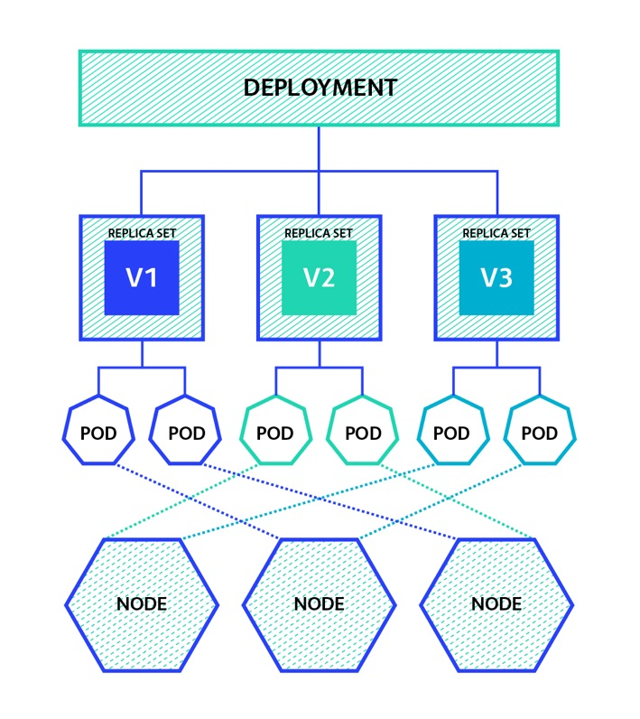
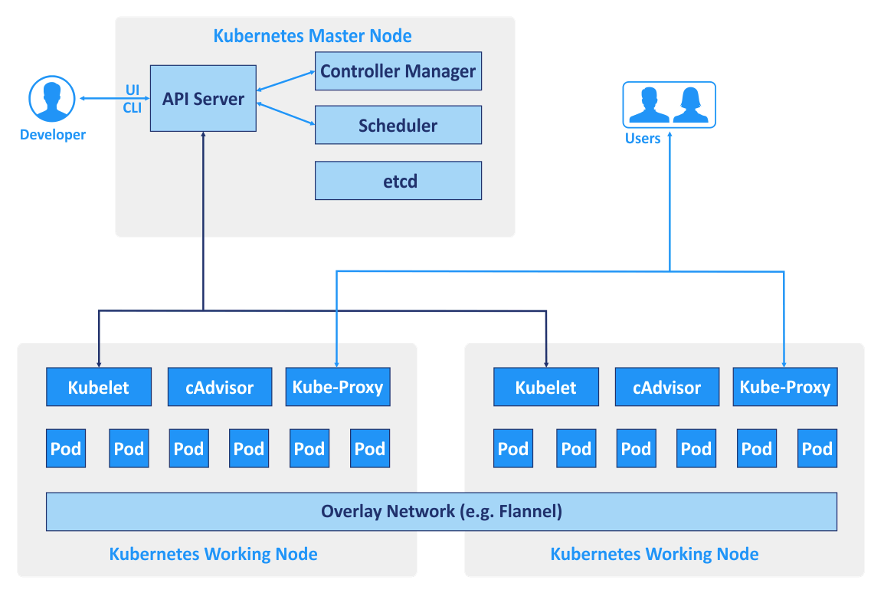
Kubernetes components & architecture :
components
architecture

Slide 16
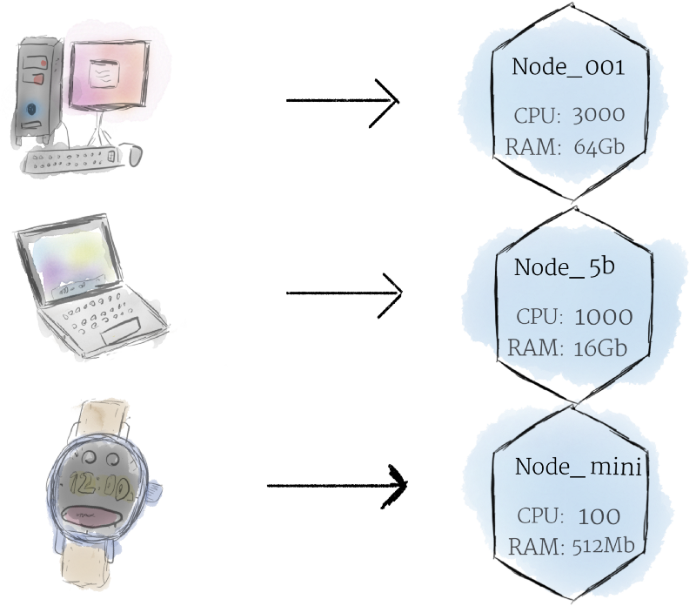
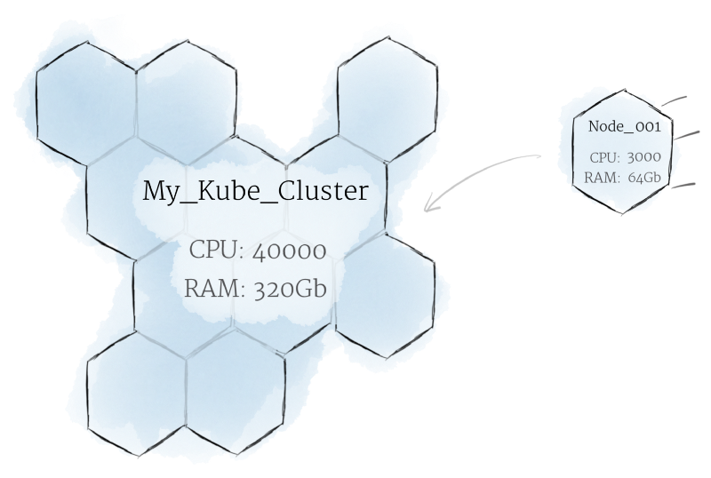
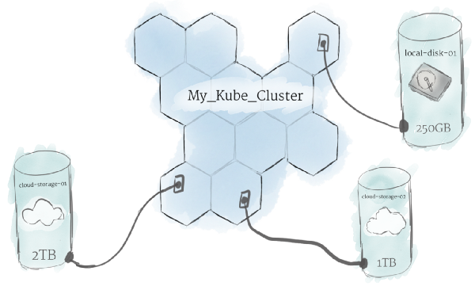

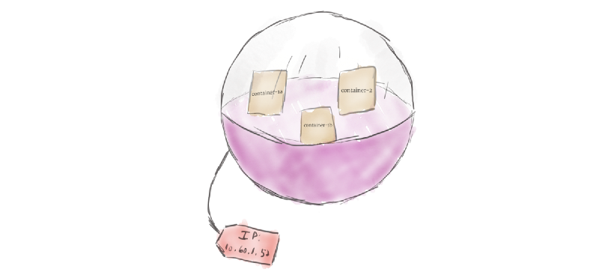
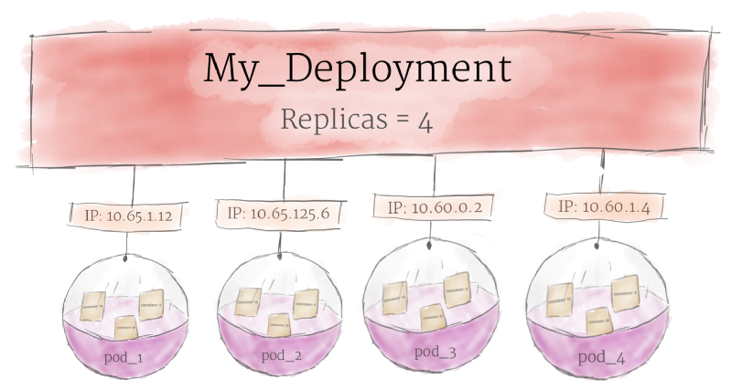
K8s components :

